Slide 1


MindSpore TSC Meeting Apr 16 2020

Slide 2
Antitrust Policy Notice
MindSpore community meetings involve participation by industry competitors, and it is the intention of the MindSpore community to conduct all of its activities in accordance with applicable antitrust and competition laws. It is therefore extremely important that attendees adhere to meeting agendas, and be aware of, and not participate in, any activities that are prohibited under applicable antitrust and competition laws in the member representative's nation or state.

Slide 3
MindSpore Useful Information
Web site: www.mindspore.cn (Chinese/English Display)
Gitee: gitee.com/mindspore GitHub: github.com/mindspore-ai Slack: Join
IRC: #mindspore-tsc (for meeting logs only) Conference: https://meet.jit.si/MindSporeTSC
Mail Lists: https://mailweb.mindspore.cn/postorius/lists/mindspore-tsc.mindspore.cn/
Logo:
https://gitee.com/mindspore/community/blob/master/MindSpore-logo.png
https://github.com/mindspore-ai/community/blob/master/MindSpore-logo.png
Presentation Template:
https://gitee.com/mindspore/community/tree/master/slides
https://github.com/mindspore-ai/community/tree/master/slides
Charter:
https://gitee.com/mindspore/community/blob/master/governance.md
https://github.com/mindspore-ai/community/blob/master/governance.md

Slide 4
Agenda
Roll Call
Community Progress Update
Governance Charter Review
SIG/WG Report Pipeline
Operational Matters

Slide 5
Roll Call
(First name alphabetically ordered)
Affiliation | TSC Member
University of Edinburgh | Amos Storkey
Conic AI Technology | Han Xiao
ICBC's Big Data and Artificial Intelligence Lab | Jianjun Chen
Tsinghua University | Jun Zhu
University Paris-Sacla | Joel Falcou
Apulis Technology | Jin Li
Huawei | Lei Chen (Chair)
Xidian University | Maoguo Gong
Imperial College London | Peter Pietzuch
Key Lab of Intelligent Information Processing of the Institute of Computing Technology (ICT), Chinese Academy of Sciences (CAS) | Shiguang Shan
University of Muenster | Sergei Gorlatch
Harbin Institute of Technology | Tonghua Su
University of Science and Technology of China | Xiangyang Li
Peking University/Pengcheng Lab | Yonghong Tian

Slide 6
Community Progress Update
Promotions:
CNCF Webinar
LFAI Blogpost
CNCF Blogpost
ONNX Virtual Meetup / Bilibili
Upcoming Events:
Live streaming course on bilibili for China audience
Eclipse Foundation blogpost (mid May)
Conferences
MindSpore Deep Learning Framework
MindSpore FrontEnd Expression
Python API
Training/Inference/Export
Data Processing
Data Format Transformation
MindSpore IR
GHLO
High Level Optimization
Auto Parallel
Auto Differentiation
MindSpore Graph Engine (Ascend/GPU/CPU Support)
GLLO
Low Level Optimization
Pipeline Parallel
Grpah Execution
On-Device Execution
Distributed Libs (Comms/PS)
MindSpore Backend Runtime (Cloud/Edge/Mobile)
CPU
GPU
Ascend 310
Ascend 910
Android/iOS

Slide 7
Community Progress Update
Initial SIGs:
FrontEnd, Compiler, Executor, ModelZoo, Data, GraphEngine, Visualization, Armour
Initial WGs:
Doc，Infra
Four SIGs (Data, Executor, Frontend, Visualization) have completed their structure document: https://gitee.com/mindspore/community/tree/master/sigs
MindSpore Deep Learning Framework
MindSpore FrontEnd Expression
Python API
Training/Inference/Export
Data Processing
Data Format Transformation
MindSpore IR
GHLO
High Level Optimization
Auto Parallel
Auto Differentiation
MindSpore Graph Engine (Ascend/GPU/CPU Support)
GLLO
Low Level Optimization
Pipeline Parallel
Grpah Execution
On-Device Execution
Distributed Libs (Comms/PS)
MindSpore Backend Runtime (Cloud/Edge/Mobile)
CPU
GPU
Ascend 310
Ascend 910
Android/iOS

Slide 8
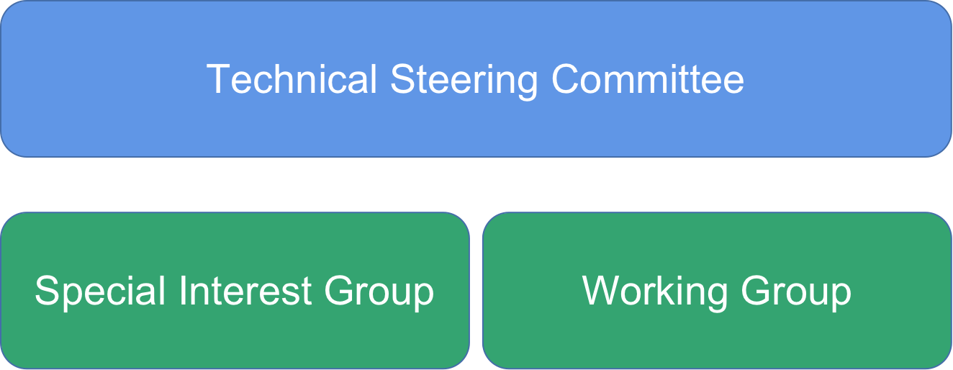
Governance Charter Review
https://gitee.com/mindspore/community/blob/master/governance.md
https://github.com/mindspore-ai/community/blob/master/governance.md

Slide 9
SIGs/WGs Report Pipeline
Release Plan
SIG : first prepare first report,
Frontend compatibility
Data
Modelzoo
Auto parallel related SIG

Slide 10
Operation Matters
Tick-tock meeting arrangments for TSC monthly meeting (Doodle for impromtu date)
Decision making via mailing list
Video recording will be uploaded to Bilibili and Youtube afterward
i18n support ?

Slide 11
Next Step
Start SIG/WG report via mailing list
Major Conference attendance preparation
User group charter setup

Slide 12
THANK YOU

Slide 13
Conference Name | Technology Field | Region | Country | Website | Conference Date | Online
ICML2020 | Machine Learning | Europe | Austria | https://icml.cc/Conferences/2020 | Jul 12 - Jul 18 | Yes
CVPR2020 | Computer Vision | North America | USA | http://cvpr2020.thecvf.com | Jun 14 - Jun 19 | TBD
NeurIPS2020 | Computational Neuroscience | North America | Canada | https://nips.cc/Conferences/2020 | Dec 2 - Dec 8 | TBD
SIGKDD2020 | Data Mining | North America | USA | http://www.kdd.org/kdd2020 | Aug 22 - Aug 27 | TBD
ACL2020 | NLP | North America | USA | http://acl2020.org | Jul 5 - Jul 10 | Yes
IJCAI2020 | AI | Asia | Japan | http://www.ijcai20.org | Jul 11 - Jul 17 | TBD
SIGGRAPH2020 | Computer Graphics | North America | USA | https://s2020.siggraph.org | Jul 19 – Jul 23 | TBD
SIGIR2020 | Information Retrieval | Asia | China | https://sigir.org/sigir2020 | Jul 25 - Jul 30 | TBD
ECCV2020 | Computer Vision | Europe | UK | http://eccv2020.eu | Aug 23 - Aug 28 | TBD
ICASSP2020 | Signal Processing | Europe | Spain | http://2020.ieeeicassp.org | May 4 - May 9 | Yes
COLING2020 | NLP | Europe | Spain | http://coling2020.org | Dec 8 - Dec 13 | TBD
ISCA | Computer Architecture | Europe | Spain | https://iscaconf.org/isca2020/ | May 30 – June 3 | Yes
MICRO | Computer Architecture | Europe | Greece | https://www.microarch.org/micro53/ | October 17–21 | TBD
ACMMM | Multimedia | North America | US | https://2020.acmmm.org/ | Oct 12 -16 | Yes
ECMLPKDD2020 | Machine Learning | Europe | Belgium | http://www.ecmlpkdd2020.net | Sep 14 - Sep 18 | TBD
ICAPS2020 | Robot | Europe | France | http://icaps20.icaps-conference.org | Oct 26-30 | TBD
ICME2020 | Multimedia | Europe | UK | http://www.2020.ieeeicme.org | Jul 6 - Jul 10 | TBD
ECAI2020 | AI | Europe | Spain | http://ecai2020.eu | Aug 29 - Sep 2 | TBD
INTERSPEECH2020 | Speech processing | Asia | China | https://interspeech2020.org | Oct 26 - Oct 29 | TBD
KubeCon Europe | Open Source | Europe | The Netherlands | https://events.linuxfoundation.org/ | Aug 13-16 | TBD
KubeCon Shanghai | Open Source | Asia | China | https://events.linuxfoundation.org/ | Jul 28-30 | Yes
Open Source Summit Japan | Open Source | Asia | Japan | https://events.linuxfoundation.org/ | Sep 15-16 | TBD
Open Source Summit Europe | Open Source | Europe | Ireland | https://events.linuxfoundation.org/ | Oct 26-28 | TBD
EclipseCon | Open Source | Virtual | Virtual | https://www.eclipsecon.org/2020 | October 20 - 22 | Yes

